Slide 1
Suggestions for WTS Zoom-Group Instructors
By Linda LaRocque
General
Setup a “recurring” Zoom meeting that can be used for all group meetings.
Setup a Google Drive folder to be used as a repository for maps, Grad Hike planning, student sign-ups, and other useful information.
PowerPoint slides become a very important component of teaching, and they can be quite effective. They might arguably be more effective with folks that are used to interacting online vs. meeting in person.
Student bonding takes a bit longer, but it definitely happens. The Zoom group students may likely be a bit more diverse, have different work situations, or be traveling from far locations. A big part of making the Zoom Group work is accommodating students’ circumstances and promoting a “team feel” during field days.
Reworking the Prescribed WTS Schedule
A pack review, typically done during Meeting #1, can be done during a field day. A group picture can be taken at the beginning of Dry Land Travel Day.
After Dry Land Travel Day, find a location that is weather friendly, to do a Navigation Study Hall with the students (our DLT field day was at NCAR, and we met at Harlow Platts Community Park, 1360 Gillaspie Dr, Boulder, CO 80305, which had a pavilion with picnic tables). Play up this post-hike gathering as a social hour, encouraging folks to bring snacks and a beverage. Some will have all the points plotted, which you can verify. Others may be struggling, which is not unexpected. Encourage students to help each other.
Students will need a paper, color Navigation Day map prior to Meeting #2. Send a PDF copy of the Navigation Day map prior to Meeting #1. During Meeting #1 ask students if they have access to a color printer (or can go to a Kinkos, etc.). For those students that do not, mail them a paper copy.
Grad Hike planning is all done online. A CalTopo demo is imperative, and students will take that tool and run with it. They might need an extra Zoom session to do their trip planning.

Slide 2
Meeting #1
List of introduction questions
Current session schedule – walk through and review meeting dates, field days, homework
Picture of compass to purchase

Slide 3
Introductions
Name
How long you’ve lived in Colorado and where you’re from
Reason for taking WTS
Hiking experience (Climbed a 14er? Hiked above treeline? Previous compass experience? Snow travel?)
Plans to take other CMC schools?

Slide 4
WTS Spring 2026 Group 11
Date
Time Notes
Prior to Meeting
Group Meeting 1 | Tue, Apr 7 | 7:00 | Basic equipment for hiking, personal hygiene, leave no trace | Read Section I - Fundamentals (Chapters 1 - 7) Watch video – Gear and Hygiene
Group Meeting 2 | Tue, Apr 14 | 7:00 | Map & Compass, plot points | Read Section II - Navigation (Chapters 8 - 9) Watch video – Map and Compass Section I homework due
Field Day 1: Dry Land Travel Day | Sat, Apr 18 | TBD | NCAR (National Center for Atmospheric Research) Boulder Open Space Mountain Parks Table Mesa Trail, Boulder, CO 80305
Optional Tutoring Map & Compass Study Hall | Tue, Apr 21 | 6:30 | The Lodge at CMC Basecamp 15605 W 32nd Ave, Golden, CO
Field Day 2: Navigation Day | Sat, Apr 25 | TBD | Little Scraggy Colorado Trail parking lot near intersection of CR 126 and FR 550
Group Meeting 3 | Tue, Apr 28 | 7:00 | Snow Travel, start Grad Hike planning | Read Section IV - Snow Travel (Chapters 15 - 16) Watch video – Avalanche Section II homework due
Field Day 3: Snow Travel Day | Sat, May 2 | TBD | Loveland Pass
Group Meeting 4 | Tue, May 12 | 7:00 | Emergency Situations, Incident Management, continue Grad Hike planning | Read Section III - Emergencies (Chapters 10 - 14) Watch video – Emergency Situations Section IV homework due
Field Day 4: Survival Day | Sat, May 16 | TBD | Reynolds Park 13649 S Foxton Rd, Conifer, CO 80433 | Watch video – Survival Field Day
Group Meeting 5 | Tue, May 19 | 7:00 | Weather, continue Grad Hike planning | Read Section V - Graduation (Chapters 17-19) Watch video – Weather Section III homework due
Field Day 5: Grad Hike | Sat, May 30 | TBD | Hall Ranch 31635 CO-7, Lyons, CO 80540
Linda LaRocque | Travis Doris | Make-Up Field Days
720.339.4759 | 720-231-4594 | Dry Land Travel -- Saturday, May 9, 2026
linda@yorkstreetllc.com | travis.doris@gmail.com | Navigation -- Saturday, May 9, 2026 Snow Day -- Saturday, May 23, 2026
Jason Gross | Carrie Schroeder | Survival -- Saturday, June 6, 2026
208-403-3248 144jfg@gmail.com | 970-631-1183 cschroeder2273@gmail.com | Grad Hike -- Saturday, June 13, 2026

Slide 5

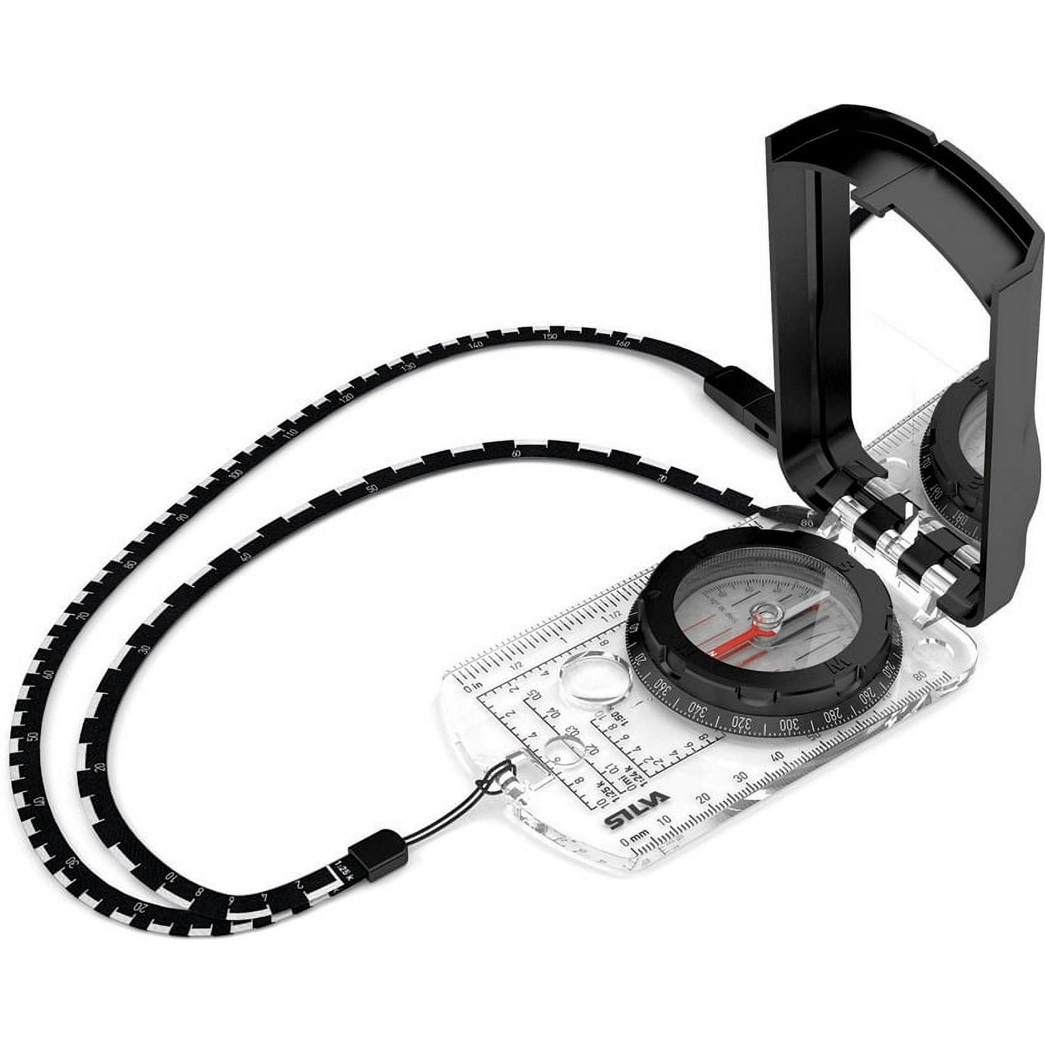

Slide 6
Meeting #2
Parts of a compass
Picture of Navigation Day map – discuss all parts of a map
Meridian lines – describe how to draw meridian lines
List of points – describe that we will find all these points on the map (and in the field) using a bearing and distance
First point description – walk through how we will find the point
Picture of compass set and aligned on map
Picture of how to measure distance
All points shown on map – “This is what your map should look like when you’re done.”
Route Plan to be completed by each student prior to Navigation Day.
Picture of how to align compass to get from first point to second point

Slide 7
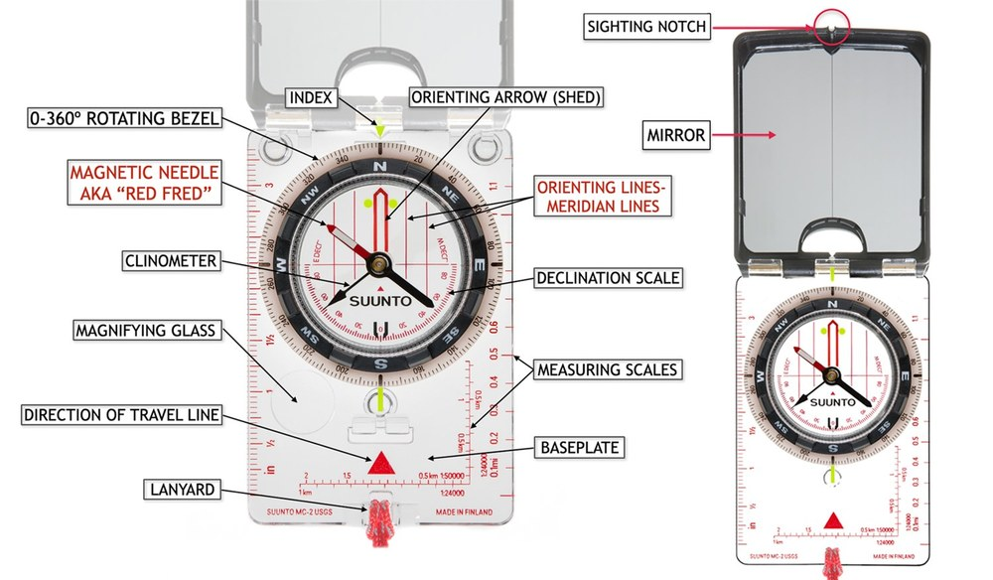

Slide 8
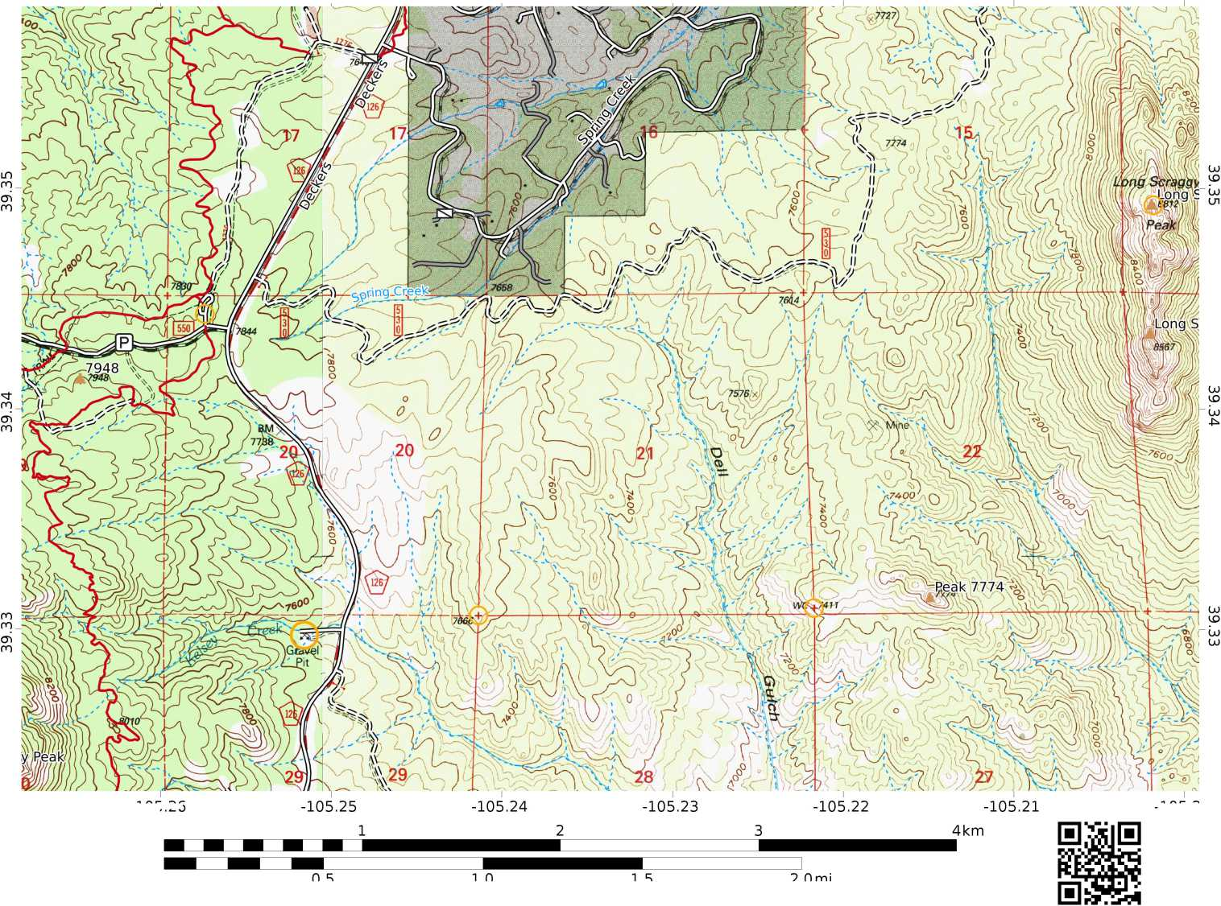
-105.26
-105.25
-105.24
-105.23
-105.22
-105.21
-105.2
-105.26
-105.2
Long Scraggy-F23-HR
WGS84
UTM Zone 13S
<J>C/ILTOPO
MN 7.8^{Q}
Scale 1:24000 1 inch = 2000 feet

Slide 9
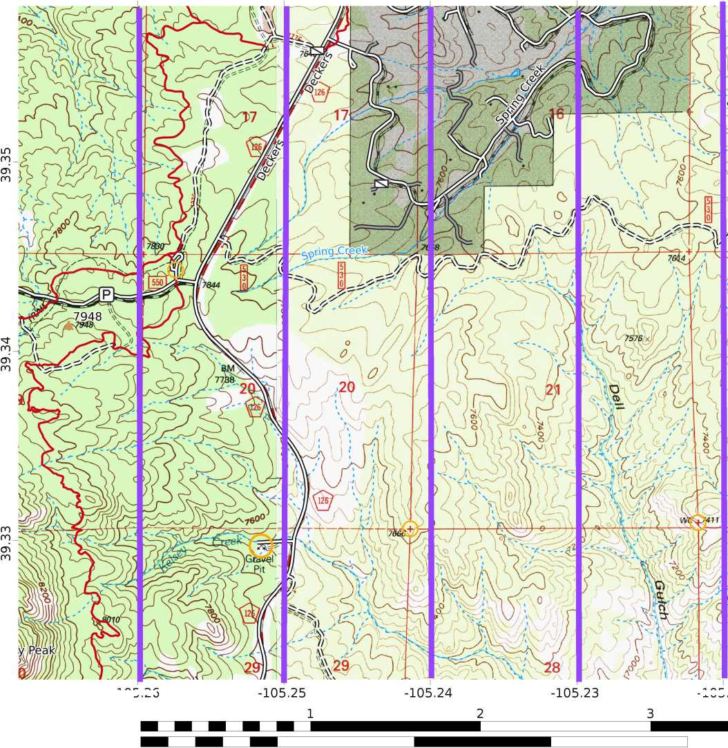
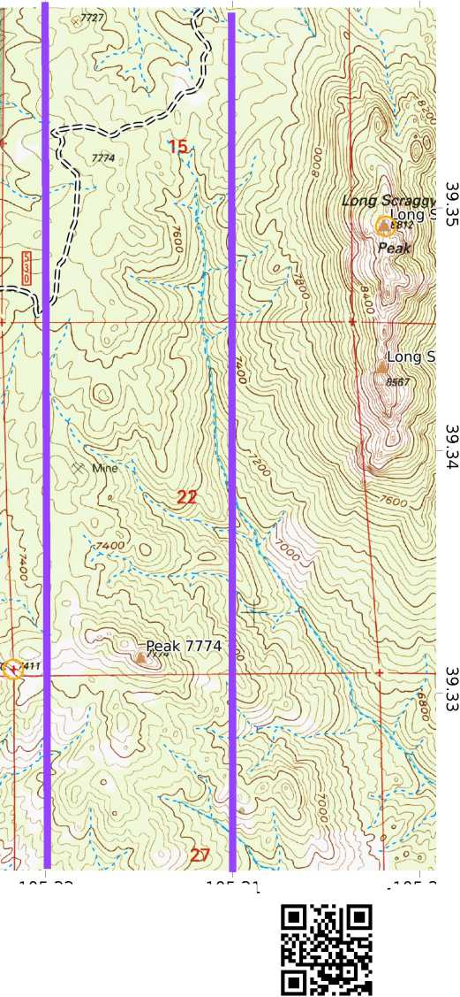
-105.26
-105.25
-105.24
-105.23
-105.22
-105.21
-105.2
-105.26
-105.22
-105.21
-105.2
Long Scraggy-F23-HR
WGS84
UTM Zone 13S
<J>C/ILTOPO
4km
0.5
1.0 1.5
Scale 1:24000 1 inch = 2000 feet
2.Omi
MN 7.8^{Q}

Slide 10
Point | From | Plot | Description | Notes
00 | Summit of Long Scraggy Peak | Bearing 263˚ 3 miles | Parking lot is 0.1 mile NW of junction of Forest Rd 550 and County Rd 126 | Marked by sign at entrance to parking lot loop (shown by yellow circle).
14 | Intersection of sections 20, 21, 29, and 28 | Bearing 346˚ 0.58 miles | Closed contour | High point of a hill with several rounded boulders
13 | WC 7411 near southern border of adjacent sections 21 & 22 | Bearing 297˚ 1 mile | Closed contour | Rock outcrop with many large rounded boulders
11 | Center of Gravel Pit symbol, near Kelsey Creek, in section 29 | Bearing 79˚ 0.92 miles | Closed contour | Rocky hilltop of large boulders
10 | Summit of Long Scraggy Peak | Bearing 234˚ where line crosses stream in Dell Gulch 1.75 miles | At confluence of stream with two intermittent streams | Creek is dry.
02 | From point 00 | Bearing 91˚ 1.1 Miles | Loop of 7600’ contour line crossing unimproved road in section 21 | Three boulders and a tree with an orange painted ring on the south side of the road.

Slide 11
-105.26
-105.25
-105.24
-105.23
-105.22
-105.21
-105.2
Point | From | Plot | Description | Notes
00 | Summit of Long Scraggy Peak | Bearing 263˚ 3 miles | Parking lot is 0.1 mile NW of junction of Forest Rd 550 and County Rd 126 | Marked by sign at entrance to parking lot loop (shown by yellow circle).
-105.26
-105.2
Long Scraggy-F23-HR
WGS84
UTM Zone 13S
<J>C/ILTOPO
MN 7.8^{Q}
Scale 1:24000 1 inch = 2000 feet

Slide 12
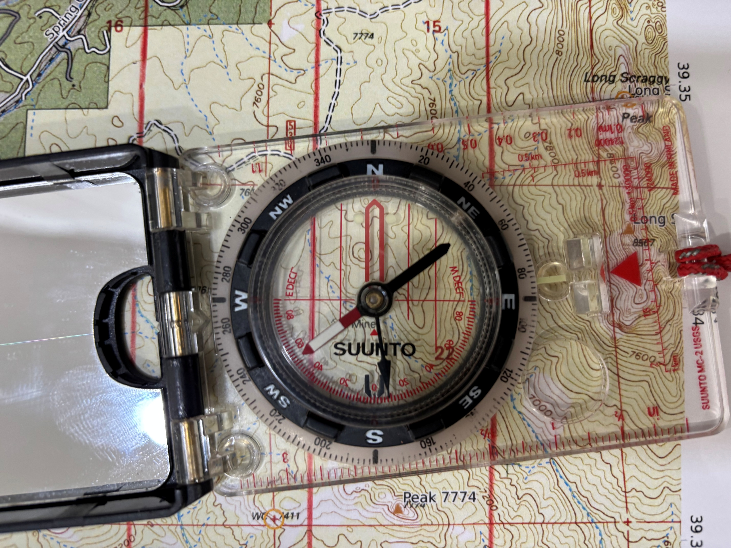

Slide 13
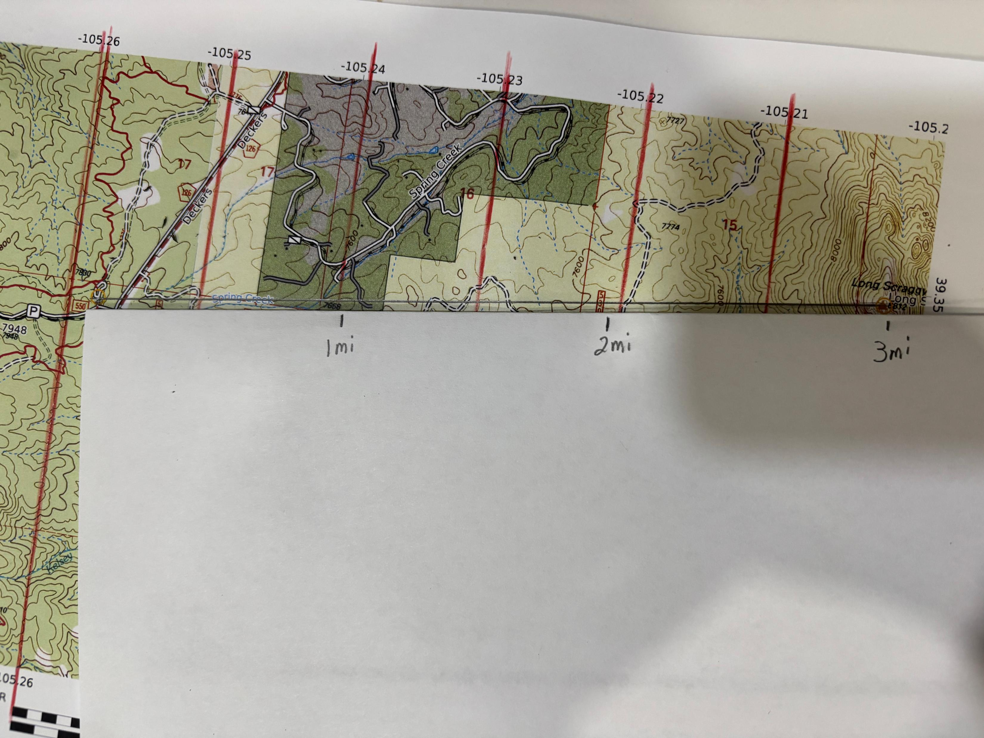

Slide 14
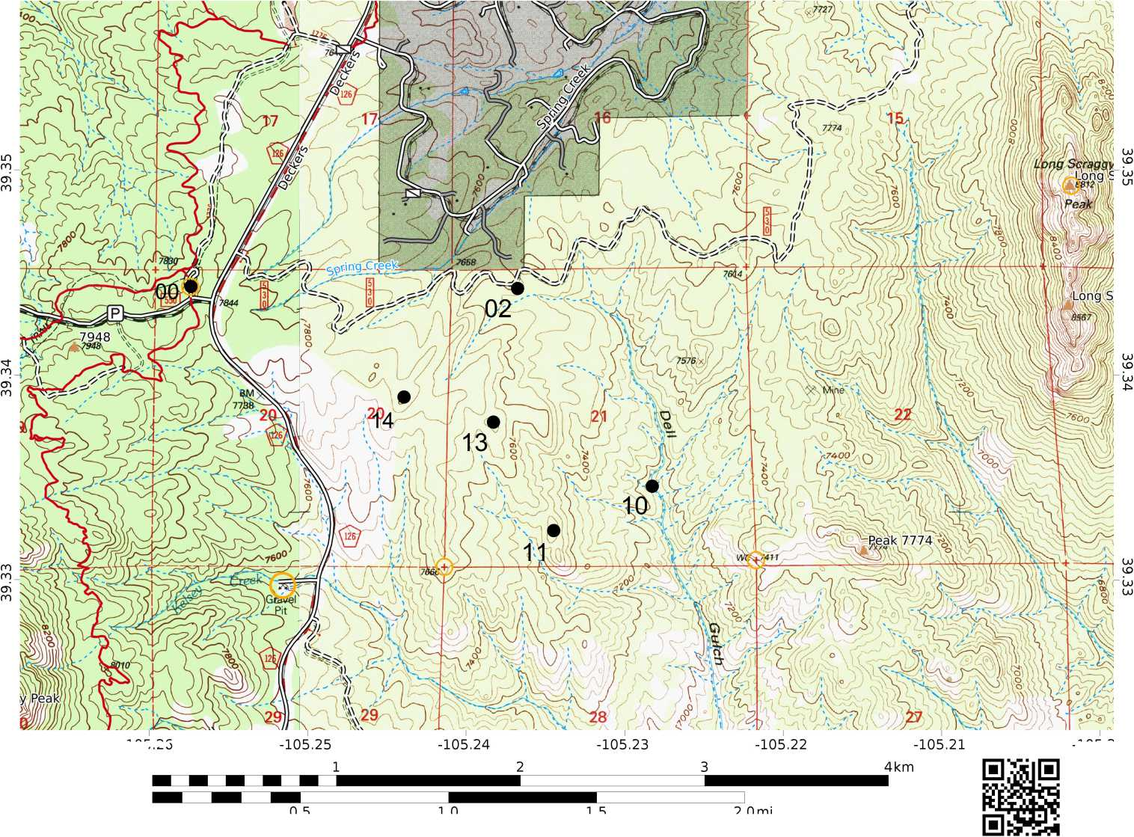
-105.26
-105.25
-105.24
-105.23
-105.22
-105.21
-105.2
-105.26
-105.2
Long Scraggy-F23-HR
WGS84
UTM Zone 13S
<J>C/ILTOPO
MN 7.8^{Q}
Scale 1:24000 1 inch = 2000 feet

Slide 15
Plan route by estimating the bearing and distance from point to point in the table provided. (You will decide on the field day whether to follow bearings, terrain, or trail from point to point.)
Nav from Pt to Pt | Distance in Miles | TRUE Compass Bearing | MAGNETIC Bearing
0 to 14
14 to 13
13 to 11
11 to 10
10 to 2
2 to 0

Slide 16
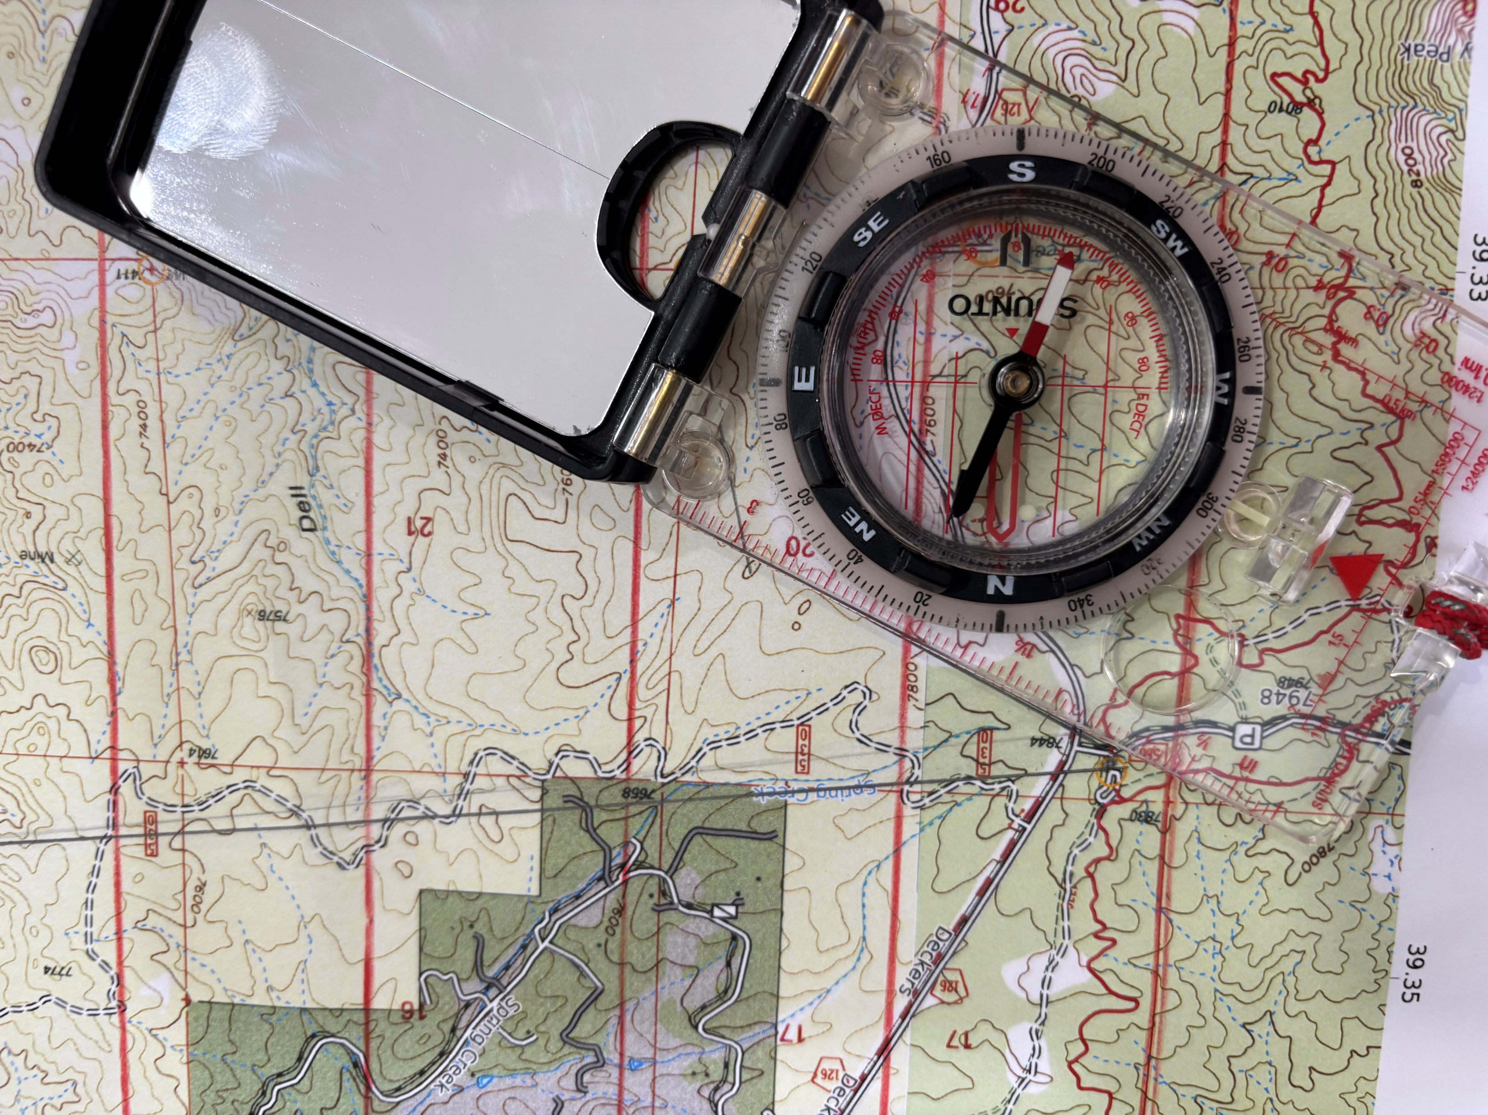

Slide 17
Meeting #3
Graduation Hike assignment
Graduation Hike rules
Graduation Hike considerations
Time estimation
Route planning example
** Caltopo Demonstration **

Slide 18
Graduation Hike Assignment
On the map, there are at least 20 closed contours above 6,000’.
Your assignment will be to go to 3 of those closed contours.
Each of the 3 destinations must be at least 0.4 miles apart (as the crow flies).
Goal is to have a third or more of the planned route off trail.
Determine areas you CANNOT go
Hike must be at least 5 miles.
Submit a completed WTS Grad Hike Trip Plan at our Tuesday, May 19 meeting. Include a map with the intended route.

Slide 19
Graduation Hike Rules
You may NOT scout the location or planned driving route prior to the trip.
You may NOT contact the park or forest service
You should NOT use a GPS device on the Grad Hike field day
Everyone must have a role in the group’s trip planning (e.g. assign a trip-plan section to each student).
Everyone must take a turn at being the Front/Hike Leader

Slide 20
Graduation Hike Considerations
The hike should consider the fitness of the students in the group.
By analyzing the topography, consider the effort involved in ascending each high point.
Use any available resources, including instructors
It may be helpful to develop at least two possible routes for the group to choose from
Meeting outside of designated class time may be needed.

Slide 21
Time Estimation
    Intended pace (distance/time) PLUS vertical/ascent rate PLUS breaktime
    Moderate on-trail pace is 2 mph
    Moderate off-trail pace is 1 mph
    Add 30 minutes for every 1,000’ of ascent.
    How many breaks and for how long?
    Time for navigating and routefinding
    Estimate time for each segment

Slide 22
Route Planning Example
Leg | Skill | Roles | Start | Manner | Dist | Destination | Fail-Safe
1 | On-Trail | Ldr- Sally RLdr - Joe | TH at north parking lot | West on Meadow Trail | 0.5 mi | Junction with Deer Trail | Sharp bend in trail
2 | Follow terrain | Ldr- Kent RLdr- Sam | Meadow-Deer Trail junction | Follow streambed | 0.6 mi | Slope flattens out | Outcrop
3 | Follow bearing | Ldr- Brian RLdr- Meg | Flat area | 85° magnetic | 0.3 mi | Intersection with 15° bearing on Sheep Peak | Terrain descends
4 | View summit | Ldr- Lara RLdr- Kay | At designated bearing | Easiest route up slope | 250 ft | Summit | Terrain descends
5 | Etc., Continue planning route back to trailhead.

